Slide 1
Persuasive Appeals
& The Art of Rhetoric

Slide 2
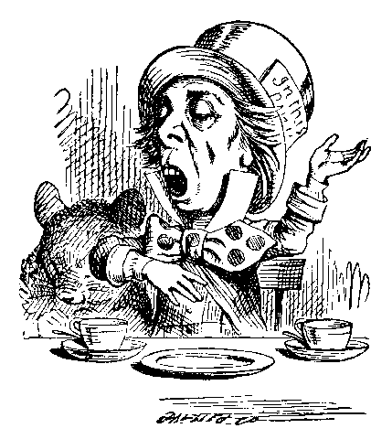
Rhetorically Speaking...
Rhetoric-
The art of speaking
or writing persuasively

Slide 3
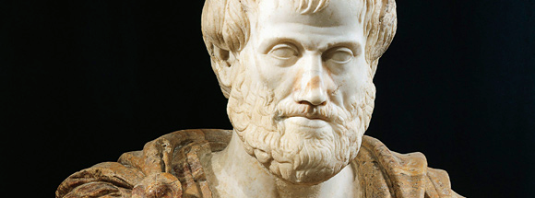
Persuasive Techniques
ARISTOTLE’S RHETORICAL APPEALS:
Logos- Appeal to logic (reasoning, facts, & statistics)
Pathos- Appeal to emotion (Powerful words, imagery, anecdotes/stories)
Ethos- Appeal to credibility (Reference credible sources, demonstrate trust, explain why credible to talk about topic)
Video

Slide 4
Defining the Rhetorical Appeals
Each of the following cartoon strips you are about to view uses a different rhetorical appeal. Identify the rhetorical appeal by answering the following questions:
What appeal is being used?
How do I know which appeal is being used?

Slide 8
Pathos
How is this add trying to make you feel?
Pathos is the appeal to our emotions. A successful appeal to our emotions makes us feel something in hopes of making us want to act on that feeling.

Slide 9
LOGOS
How does this strip guide our reasoning?
Logos is the appeal to logic. When persuading, this technique appeals to your audience’s ability to reason by using facts and logic to guide your thought process.

Slide 10
ETHOS
Why should you trust this information?
Ethos is the appeal to the credibility of the speaker. Essentially, it answers the question, “Why should I trust or believe YOU?”

Slide 11
Ad Analysis:
Assignment: Grab a few magazines and skim them for advertisements that use the rhetorical appeals.
Requirements:
Locate and cut out one advertisement that you feel is a good example of each appeal (three ads, one for each appeal)
Glue each ad to the poster paper provided (label it)
Under the ad, write a brief explanation for each ad that explains which appeal is being used, how it is being used, and whether or not you believe it is ethical (Do you feel like it is being too manipulative? Is the ad using an appeal at the expense of someone/group of people?)

